Slide 1
Negative Number (Sign & Magnitude)
Negative number always written with sign at the front:
  Example:
    -(20)₁₀, -(100)₁₀,
In computer memory, sign is represent by number
  0 for +
  1 for -

Slide 2

Negative Number (Sign & Magnitude)
Example: 8-bit number consist of 1-bit sign and 7-bit magnitude
Sign Magnitude

Slide 3
Mathematical Binary Operation
3 ways to represent negative numbers
  Convert sign bit
  Use first complement (1’s complement)
  Use second complement (2’s complement)

Slide 4
Negative Number (Sign & Magnitude)
Largest positive number 0 1111111 +(127)₁₀
Largest negative number 1 1111111 -(127)₁₀
Zero 0 0000000 +(0)₁₀
1 0000000 -(0)₁₀
Range: -(127)₁₀ to +(127)₁₀
‘Sign number' needs negative number
Representation: Sign & Magnitude

Slide 5

Negative Number (Sign & Magnitude)
To negative a number, just change the sign bit
Example:

Slide 6
Negative Number (Sign & Magnitude)
Two ways to represent negative number
  Use first complement (1’s complement)
  Use second complement (2’s complement)

Slide 7
Negative Number (Sign & Magnitude)
3 ways to represent negative numbers
  Convert sign bit
  Use first complement (1’s complement)
  Use second complement (2’s complement)

Slide 8
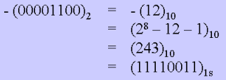
First Complement
Number x, n-bit can represent first complement
Example:

Slide 9
First Complement
The easiest way to get first complement is by inverting all bits
Example: -(00000001)_{1s} =(11111110)_{1s}
-(11111110)_{1s} =(00000001)_{1s}
Largest positive number 0 1111111 +(127)
Largest negative number 1 0000000 –(127)
Zero 0 0000000 +(0)
1 0000000 –(0)
Range: –(127)₁₀ to +(127) ₁₀
MSB still represent sign bit
  0 = +ve and 1 = -ve

Slide 10
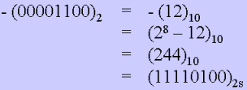
Second Complement
Number x, n-bit can represent second complement
-x=2^{n}-x
Example:

Slide 11
Second Complement
The easiest way to get second complement is by inverting all bits and plus 1
Example: -(00000001)_{2s} = (11111110)_{1s} (invert)
= (11111111)_{2s} (plus 1)
-(01111110)_{2s} = (10000001)_{1s} (invert)
= (10000010)_{2s} (plus 1)

Slide 12
Second Complement
Largest positive number 0 1111111 +(127)
Largest negative number 1 0000000 –(128)
Zero 0 0000000 +(0)
Range: –(128)₁₀ to +(127) ₁₀
MSB still represent sign bit
  0 = +ve and 1 = -ve

Slide 13
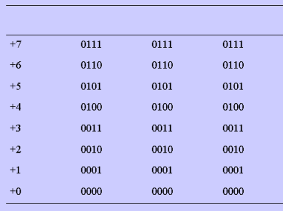
Comparison Between Magnitude-and-Sign and Complement
Example: 4-bit signed bit (positive value)
Value Magnitude- first second
and-Sign complement complement

Slide 14
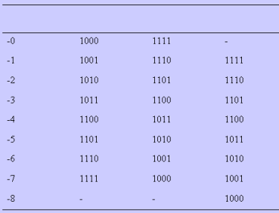
Comparison Between Magnitude-and-Sign and Complement
Example: 4-bit signed bit (negative value)
Value Magnitude- first second
and-Sign complement complement

Slide 15
Complement
Complement number can execute subtraction operation. With complement, subtraction can be done using addition
Generally, number base-r, we have:
  Reduced Radix Complement (or r-1)
  Radix Complement (or r)
For base-2 number, we have
  First complement
  Second complement

Slide 16
Reduced Radix Complement
Given n-digit number, N_{r},therefore (r-1) complement is
(r^{n}-1)-N
Example:
(r-1) complement, or ninth complement for (22)₁₀ is: (10²-1)-22=(77)_{9s}
(r-1) complement, or first complement for (0101)₂ is: (2⁴-1)-0101=(1010)_{1s}
Similar to inverting all digit
(10²-1)-22=(77)_{9s}
(2⁴-1)-0101=(1010)_{1s}

Slide 17
Radix Complement
Given n-digit number, N_{r}, therefore (r-1) complement is
r^{n}-N
Example:
r complement, or tenth complement for (22)₁₀ is: 10²⁻22=(78)_{10s}
r complement, or second complement for (0101)₂ is: 2⁴-0101=(1011)_{2s}
Similar to inverting all digit and plus 1
10²-22=(99+1)-22=77+1=(78)_{10s}
2⁴-0101=(1111+1)-0101=1010+1=(1011)_{2s}

Slide 18
Subtraction using r Compliment
Subtraction technique
Given two n-digit base-r unsigned numbers, M & N, Subtraction for (M-N) is as:
  Add M to r-compliment for N
    M+(r^{n}-N)=(M-N)+r^{n}
  If M≥N, there is one final carry r^{n}, ignore final carry to obtain answer as
    M-N
  If M≤N, no final carry r^{n}, but there is negative result:(M-N)+r^{n}. To obtain normal form, use r-compliment
    r^{n}-((M-N)+ r^{n} =N-M
  Put negative sign in front

Slide 19
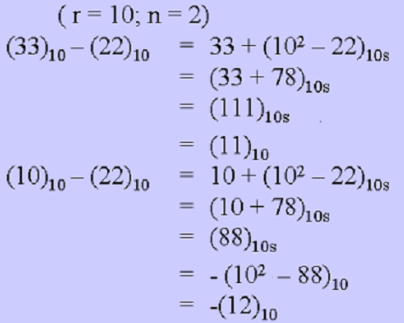
Subtraction using r Compliment
E.g
(ignore final carry)
(answer)
(no final carry, it’s complement)
(answer)

Slide 20
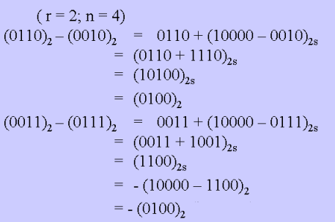
Subtraction using r Compliment
E.g
(ignore final carry)
(answer)
(no final carry, it’s complement)
(answer)

Slide 21
Subtraction using r-1 Compliment
Subtraction technique
Given two n-digit base-r unsigned numbers, M & N, Subtraction for (M-N) is as:
  Add M to r-compliment for N
    M+(r^{n}-1-N)=(M-N-1)+r^{n}
  If M≥N, there is one final carry r^{n}, ignore final carry to obtain answer as
    (M-N-1)+1=M-N
  If M≤N, no final carry r^{n}, but there is negative result:(M-N-1)+r^{n}. To obtain normal form, use r-compliment
    r^{n}-((M-N-1)+ r^{n} =N-M
  Put negative sign in front (if answer is not zero)

Slide 22
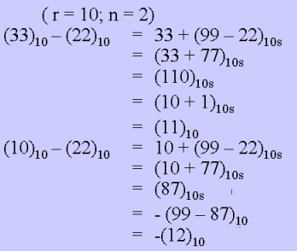
Subtraction using r-1 Compliment
E.g
(ignore final carry & plus 1)
(answer)
(no final carry, it’s complement)
(answer)

Slide 23
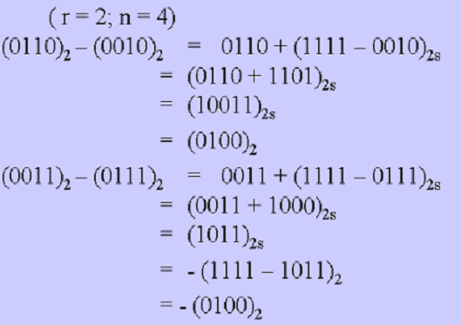
Subtraction using r-1 Compliment
E.g
(ignore final carry & plus 1)
(answer)
(no final carry, it’s complement)
(answer)

Slide 24
Signed Binary Subtraction
Signed binary subtraction is similar to unsigned binary subtraction
The final step which convert to negative number is not needed
MSB shows whether the number is negative or positive

Slide 25


Signed Binary Subtraction
Generally, can be subtracted from/to both negative or positive sign
  Subtract –ve from +ve
  Subtract –ve from -ve
  (no final carry)
  (no final carry)

Slide 26
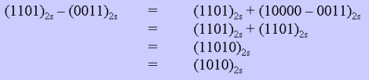
Signed Binary Subtraction
Generally, can be subtracted from/to both negative or positive sign
  Subtract +ve from -ve
  (no final carry)

